Slide 1
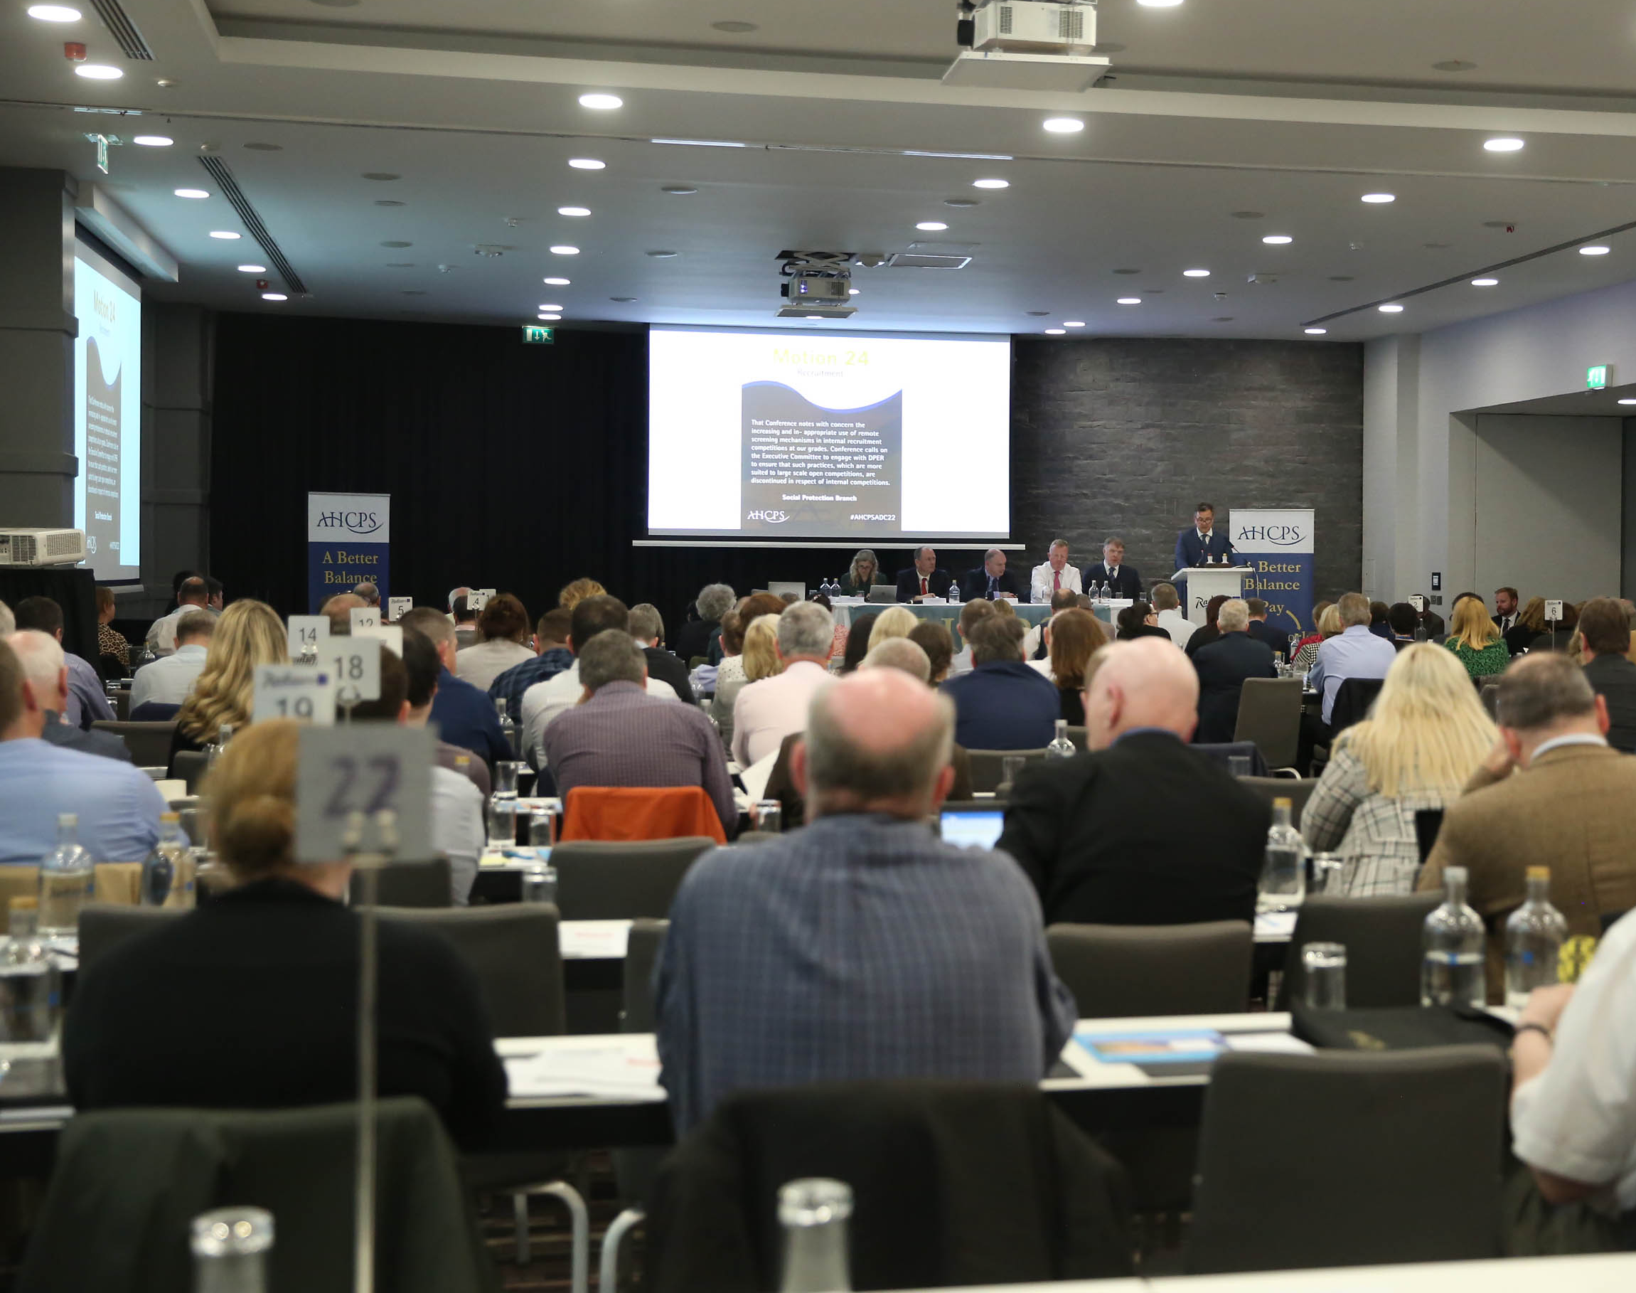
AHCPS Branch Officer Training Event
Sheraton Hotel, Athlone
30th and 31st March 2023

Slide 2
Agenda
Thursday 30th March
1.30-2pm Registration and tea/sandwiches
2.00pm Welcome
Ciaran Rohan, General Secretary
2.10pm Overview of AHCPS History, Structures and Governance Paul Malone, Deputy General Secretary
2.30pm What is the Purpose of a Union?
Larry Dunne, Industrial Relations Officer
3.00pm Recruiting New Members
Billy Thompson, Assistant General Secretary
3.30pm The Role of the Local Branch Officer
- Your Role as A Branch Rep - Case Studies on Local Issues - Representing Members – ‘Dos’ and ‘Don’ts’
Val Jeffrey, former Vice-Chairperson AHCPS Executive Committee 4.45pm Q&A / Close
7.30pm Drinks Reception Followed by Dinner
Friday 31st March
10.15am An Overview of the Conciliation and Arbitration Scheme/ Workplace Relations Commission
Ciaran Rohan, General Secretary
11.00am A View from HR on the Union-Employer Relationship
Nora O’Brien, Industrial Relations Unit, Revenue Commissioners
11.45am The Impact of Blended Working on Working Life in the Civil Service
Philip O’Callaghan, Civil Service Employee Assistance Service
12.30pm Close and Lunch

Slide 3
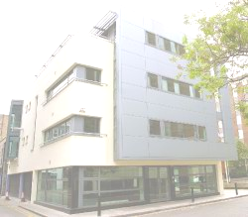
An Overview of AHCPS History, Structure and Governance
Paul Malone, Deputy General Secretary 30th March 2023
Association of Higher Civil and Public Servants

Slide 4
Contents
A very brief history of the Association
How are we structured and governed?
Rules and Constitution
Q&A
Branch Officer Training 30-31st March 2023

Slide 5
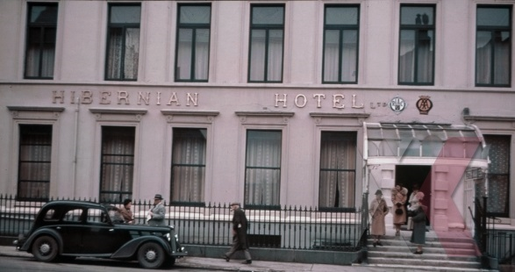
3rd December 1943 – over 200 senior civil servants met in the Royal Hibernian Hotel, Dawson Street
Agenda - freeze on salaries in place since 1940.
Established the Association of Higher Civil Servants to call for the immediate cessation of the freeze and generally represent the interests of members

Slide 6
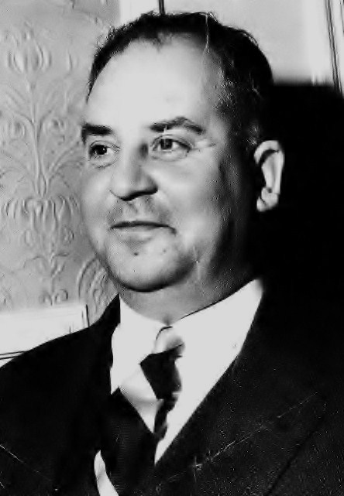
1943-1975 – AHCS operated from homes and offices
1975 – Membership at 1,022 - premises rented at 42 Dawson Street.
First employee of the Association of Higher Civil Servants – Ralph B. Pares General Secretary 1975-1980
1977 – Jackie Lacey employed to provide administrative support
1978 – AHCS affiliated to ICTU
1981 - First Annual Delegate Conference in Burlington Hotel

Slide 7
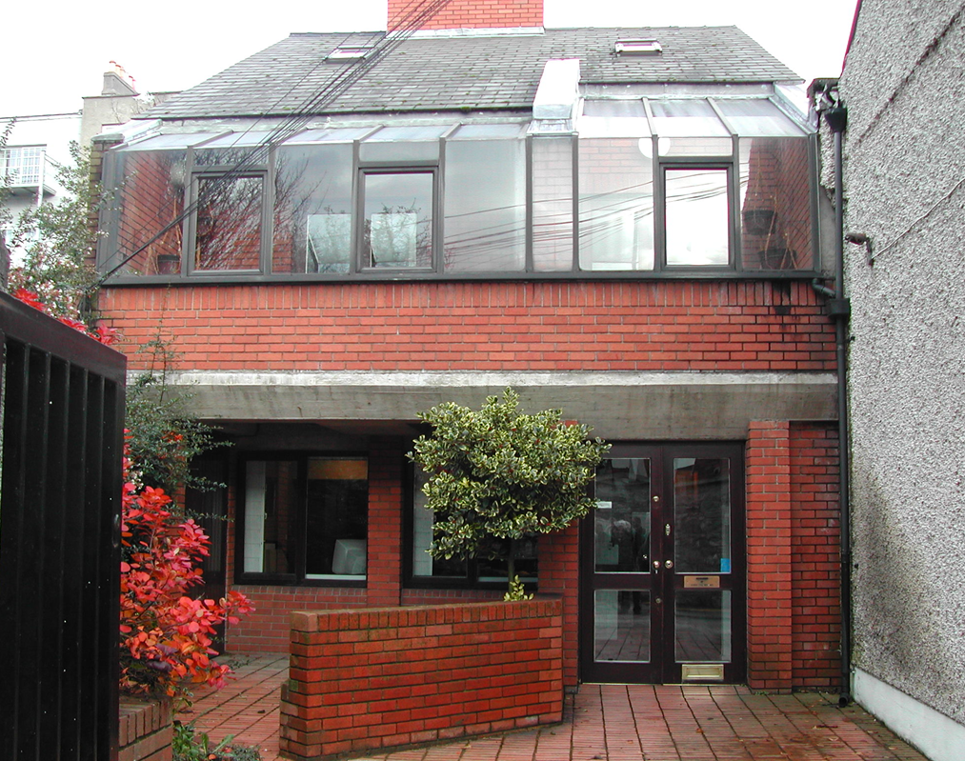
1985 - staff of three - hq premises purchased at Warner’s Lane.
1997 – the AHCS became the Association of Higher Civil & Public Servants – AHCPS.
Also in 1997, agreed that the General Secretary would act as Negotiating Secretary for the Veterinary Officers Association (VOA)

Slide 8
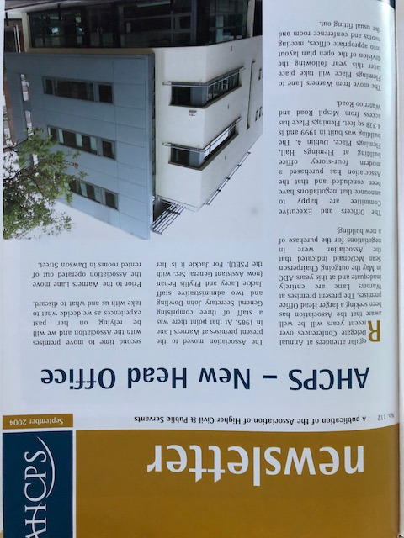
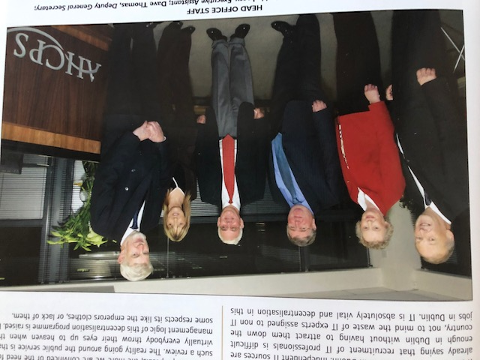
2005 – move to Flemings Place
Staff of 5…….
Membership at 3,250
Drop in membership to 2,800 during austerity – 2012-2014
Current membership at 3,650 and growing!
2023 – 80th Anniversary

Slide 9
Structure & Governance
Trustees
National Executive Committee
Chair – Trevor Noonan Vice-Chair – Orla McBreen
Treasurer – Bernard O’Shea
14 x Ordinary Members
Constitution and Rules
Full-Time Officials
General Secretary
Ciaran Rohan
Deputy General Secretary
Paul Malone
Assistant General Secretary
Billy Thompson
Industrial Relations Organiser
Larry Dunne
Local Branches x 50 - Branch Officers and Committees
Annual Delegate Conference
Members
Standing Orders Committee
Administration Staff
Service Providers
Executive Assistant
Jackie Lacey
Administrator
Jennifer Farrelly-Clarke
Consultative Council
ICTU and other Affiliations

Slide 10
Registrar of Friendly Societies
Trade Union Acts 1871-1990 – trade unions required to be registered
Must have at least 7 members (>1000 for licence)
Name not misleading to the public or too similar to another union
Must have rules in accordance with the legislation
Any amendment to the Rules must be done by application to the Registrar.
Trade union must submit accounts yearly to RFS
Must submit proposed change of name / premises to RFS
Branch Officer Training 30-31st March 2023

Slide 11
Rules and Constitution
Rule 9 – Delegate Conference
Supreme policy making body – approves annual report and accounts
Elects officers, 12 Executive Committee members and Standing Orders Committee
2 delegates for first 30 members of branch and 1 delegate for each 30 or part thereafter
Any member not a delegate can attend but cannot speak
Conference is run by the Standing Orders Committee and not the Executive Committee
Motions are passed by a simple majority except for Rule changes which require a 2/3rds majority
Branch Officer Training 30-31st March 2023

Slide 12
Rules and Constitution
Rule 11 – Executive Committee
Chair, Vice-chair, Treasurer – 12 ordinary members elected at ADC
2 members co-opted by Executive (gender, grade, small branches)
Functions of Executive: - Manage, direct and control affairs of the Association - Develop policies and strategies - Approve applications for membership - Appoint officials and staff - Appoint trustees
Branch Officer Training 30-31st March 2023

Slide 13
Rules and Constitution
Rule 12 – Standing Orders Committee
6 members (can’t be members of Executive)
Elected at ADC
Runs ADC
Rules on motions and ADC running order
Produces a report on the running of ADC
Branch Officer Training 30-31st March 2023

Slide 14
Rules and Constitution
Rule 10 – Consultative Council
Consists of Chair/Sec of branches plus Exec. Committee
Meets twice yearly
Acts as a forum where members can make views known to Executive – and Executive can seek opinion of membership
Promotes understanding between branches and between branches and the Executive
Not a decision-making body
Branch Officer Training 30-31st March 2023

Slide 15
Rules and Constitution
Rule 15 – Trustees
3 trustees appointed by the Executive
Must be members – but not of the Executive
Appointed for 5 years
Appoint auditors
Any property is vested in trustees
Branch Officer Training 30-31st March 2023

Slide 16
Rules and Constitution
Rule 22 – Branch Organisation
Each branch shall have a branch committee and a chair/secretary
keep members informed
transmit communication from head office to members
organise AGM and advise members
keep records
represent branch at Consultative Council
Branch Officer Training 30-31st March 2023

Slide 17
www.ahcps.ie
Branch Officer Training 30-31 March 2023

Slide 18
Thank you
Paul Malone, Deputy General Secretary

Slide 19
AHCPS Branch Officer Training

Slide 20
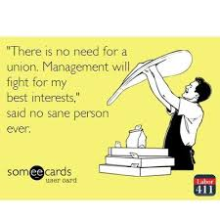
What is a Trade Union?
Definition: Trade unions are organizations formed by workers from related fields that work for the common interest of its members.
They help workers on issues like fairness of pay, good working environment, hours of work and benefits. They represent a cluster of workers and provide a link between the management and workers. Description: The purpose of a union is to look into the grievances of employees and present a collective voice to management. Hence, it acts as the medium of communication between the workers and management.

Slide 21
The 4 main Function of a Trade Union
1. Economic Function : Protect the wages and conditions
of their members.
2. Social Function: To create a broad base of support or
empathy to translate the vision of a just society into reality.
3. Legal Function: Represent members at Tribunals , Courts etc
and try to influence legislation in favour of workers.
4. Build its organisation, both numerically and financially, in order to
achieve the above .

Slide 22
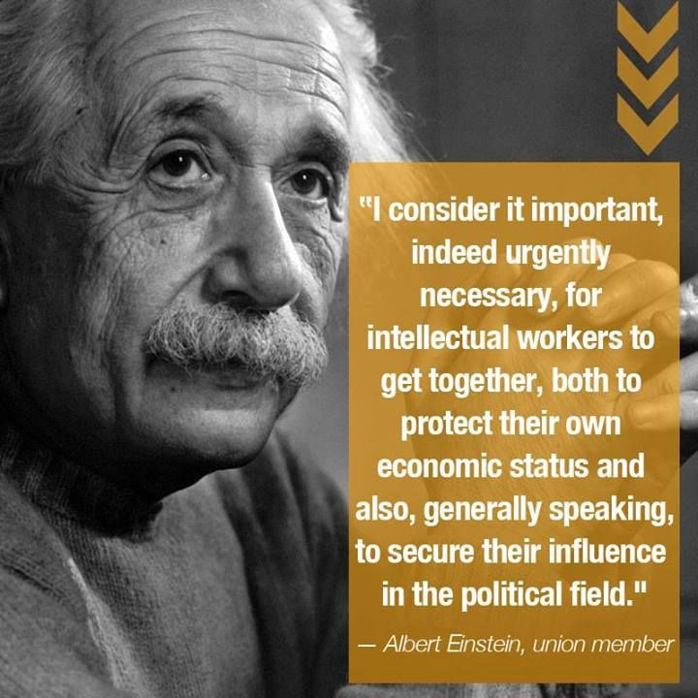

Slide 23
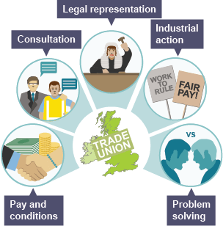

Slide 24
Six reasons why public servants should join a union

Slide 25
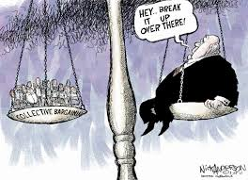
Collective bargaining on pay and conditions
Unions negotiate your pay, pensions and other terms and conditions like holiday entitlements.
In the public sector, pay has taken a battering but by 2020, more than 90% of public servants will be out of FEMPI pay provisions.

Slide 26
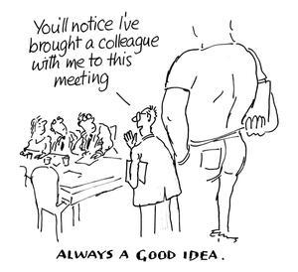
2. Personal representation
A problem at work : You will need information and advice.
Help can range from your elected rep or full-time officer providing a sympathetic ear or reassurance, to full-blown representation if a problem gets serious.
For example, in the civil service a complex new performance management scheme is being rolled out.
Your union will help you navigate your way through this minefield, and help make sure you get a fair deal.

Slide 27
3. Services
Insurance and Financial benefits for member including:
Income Continuance: Which in the event of you being retired on ill health grounds will bring your ill health retirement pension up to 75% of your salary until you reach 65 years of age.
Additional Voluntary Contribution: to increase pensions in a tax efficient manner & increasing death in service benefit.
Car, Home & Travel Insurance
Mortgage Protection & Advice.

Slide 28
4. Health and Safety
Local safety representatives have statutory rights to help protect your health and safety at work.
They deal with issues ranging from stress and mental health issues to hazards in the workplace.

Slide 29
5. Equality
Unions lead the fight for equal opportunities in the workplace. We stand for equal pay & treatment and against discrimination (including family-friendly policies such as flexible working, ensuring fair recruitment and promotions and adjustments for disabled workers.

Slide 30
Building Social Capital
Contacts
Friendship
Supports

Slide 31
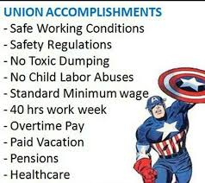

Slide 32
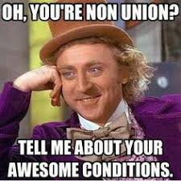
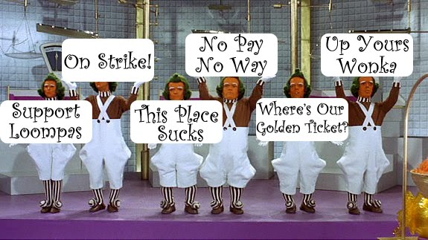
If unions aren’t needed anymore why are corporations spending billions to destroy them?

Slide 33
Recruiting New Members
Branch Officer Training Event
Sheraton Hotel
30th & 31st March 2023

Slide 34
Membership 2008 - 2022
Branch Officer Training Event 30/31 March 2023

Slide 35
Numbers Joining & Retiring 2008 - 2022
Branch Officer Training Event 30/31 March 2023

Slide 36
New Members by Year
2012 103
2013 106
2014 129
2015 215
2016 225
2017 278
2018 303
2019 410
2020 307
2021 263
2022 900
Branch Officer Training Event 30/31 March 2023

Slide 37
Current Membership
Members @ 31st December 2021: 3,335
Gender breakdown: Male: (50.6%)
Female: (49.4%)
New members 1st Jan 2022 to end October: 563
Retirements/Leavers (estimated): 198
Current Membership Circa: 3,800
Membership End of 2023 Circa: 4,000
Current Milestone - Gender Breakdown Female 50%+
Branch Officer Training Event 30/31 March 2023

Slide 38
Department/Org. | Total AP/PO Cohort | Members | % Density
Ombudsman | 63 | 57 | 90%
Finance | 119 | 70 | 59%
Defence | 77 | 57 | 74%
Education & Skills | 255 | 192 | 75%
DSP | 353 | 280 | 79%
Foreign Affairs | 389 | 290 | 74%
Courts | 179 | 125 | 70%
OPW An Post | 68 230 | 54 127 | 79% 55%
Revenue | 675 | 519 | 77%
Rural & Community | 46 | 31 | 67%
Oireachtas | 93 | 70 | 75%
Taoiseach | 62 | 41 | 66%
Agriculture | 233 | 147 | 63%
Housing & Planning | 241 | 172 | 71%
Tourism, Culture, Arts | 101 | 70 | 69%
Transport | 122 | 72 | 59%
Garda Staff | 98 | 68 | 69%
DPER (incl NSSO) | 199 | 133 | 67%
Justice | 316 | 177 | 56%
Children | 154 | 102 | 66%
Health | 222 | 132 | 60%
Environment, Climate | 145 | 87 | 60%
GSOC | 31 | 19 | 61%
Business & Enterprise | 211 | 128 | 61%
Average density 2022 =
70%
Average density 2019 =
68%

Slide 39
Member Engagement Activities – 2020-2023
Feb 26 2020 – Women in Leadership Seminar - c.150 members
June-July 2020 – Virtual Seminars - Leading and Managing Remotely – c.100 members
December 10th 2020 – The Future of Work post-Covid Seminar & Consultative Council – c.80 members
June to December 2021 – Member Health Screening – c. 600 members / Blue and Pink Power c. 450 members
3rd November 2021 – Single Pension Scheme Briefing for members / non-members – c. 100 members
17th February 2022 – Wellbeing Seminar – c. 40 members
6th July 2022 – Women in Leadership Seminar – c. 60 members
July-September 2022 – Member Health Screening – c. 300 members
19/20th September 2022 – New Member Networking Event – c. 70 members
29th March 2023 – Consultative Council on Method of Election to Executive Committee & Blended Working
2023 – Free Financial Health Check
c. 2,000 members
In total
Branch Officer Training Event 30/31 March 2023

Slide 40
Future Member Engagement Activities
Enhanced Branch Officer Training
Equality and Diversity / Disability Awareness Seminar
Revisit Career Seminars – ‘Preparing for PO & TLAC’
Targeted Recruitment Drive for Branches with Lower Density
Member Network Event Every 2nd Year
Lunch Time Information Events aimed at Non-Members
Further Well-Being Initiatives
Branch Officer Training Event 30/31 March 2023

Slide 41
Challenges in Attracting / Retaining New AHCPS Members
New entrants from Private Sector
Attitude towards unions
Dispersed locations
Collective benefits shared by non-members - ‘Free rider syndrome’
Perception of negative impact on career
Difficulty of accessing grade member information - (GDPR etc.)
Uncertainty about representation – Professional & Technical Grades
Branch Officer Training Event 30/31 March 2023

Slide 42
Recruitment at Branch Level
Identification of potential members – who, where, what? eligible?
Sell benefits of membership – Online Registration
Distribution of promotional leaflet / personal touch
Importance of follow-up -Key
Appointment of Branch Recruitment Officer
Open days for non-members
Attendance at induction seminars
Branch Officer Training Event 30/31 March 2023

Slide 43
Guidance Note on Extensive Services to Members
Accessible at www.ahcps.ie
On Line Registration Facility
Free induction period of 3-months
Direct Access to Officials
Legal Consultation when required
Pay Negotiations
Personal & Branch Representation with HR & Management
Wide Experience of Dignity at Work & Disciplinary Cases
Branch Officer Training Event 30/31 March 2023

Slide 44
Thank you
Branch Officer Training Event
Sheraton Hotel
30th & 31st March 2023
Billy Thompson, Assistant General Secretary

Slide 45
AHCPS
Branch Officer Training Seminar
Val Jeffrey 30/3/2023

Slide 46
My Own Involvement – AHCPS 2010 - 2020
Secretary & Chairman Revenue Branch AHCPS
Chairman Revenue Staff Panel
AHCPS Main-Partnership Rep Revenue
Co –Delivered Partnership Training with C.S.D. Revenue
AHCPS Executive
Vice-Chairman AHCPS 2017 – 2020
Seconded From Revenue to AHCPS 2018 - 2020

Slide 47
Involving yourself in the AHCPS
Branch Representative;
Getting Familiar with the Role
Liaising with Fulltime Officials
Important contact role for AHCPS members in your Dept.

Slide 48
The AHCPS in your Department
A Strong, Pro-active, Solution-Focused AHCPS
benefits the members
but also the Department
Where do you come in as a Branch Representative?

Slide 49
The AHCPS in your Department
Local AHCPS Contact /Liaison Person
Local Representative AHCPS
Partnership Representative AHCPS
Department Branch Committee Representative AHCPS
AHCPS Executive Member

Slide 50
The Role of a Branch Representative
Be Visible
New Members
Communicate
Be Aware of Local Issues & National Issues
Circulate Information
Hold Local Meetings
Attend Branch Meetings
Organising Branch Meetings
Know what you can deal with yourself, and - when to refer to full-time officials –
Motions for Annual Branch meeting
Motions for Annual Delegate Conference (ADC)
Attend ADC
Relationship Building

Slide 51
Representing Individual Members – Full Time Officials
National Agreements
Industrial Relations
Disciplinary Issues
Grievance Procedures
Informal Resolution of issues
Personal Cases
Work Related Matters
Legal Advice

Slide 52
Case Scenario 1
A newly promoted A.P. from an internal competition and a P.O. recruited from the private sector take up new roles in your Division.
Do you have a role as the local AHCPS Branch Rep.?

Slide 53
Case Scenario 2
A Local Member contacts you with a view to raising two important issues via motions at the upcoming;
1. Your Department’s Annual Branch Delegate Meeting
2. AHCPS Annual Delegate Conference
What do you advise in your capacity as Branch Rep.?

Slide 54
Case Scenario 3
A newly promoted A.P. from another Department contacts you and advises that they were able to work 4 days from home with only one day in the office in their previous Department.
The person has contacted you to request AHCPS support in pursuing a similar arrangement.
Their current A.P. role demands that they are required to spend 4 days in the office and can work from home for 1 day.
What do you do as the Branch Rep?

Slide 55
Case Scenario 4
A newly appointed A.P. has contacted you in a distressed state and outlined a scenario whereby at their 9 monthly assessment, the principal officer has informed them that their work has continuously not met the required standard and their P.O. is recommending to H.R. that their contract be terminated.
The A.P. further alleged that the P.O. had been putting excessive pressure on them, allocating them unfair workloads and contacting them late in the evening by email and phone requesting reports by 9.00am the following morning. The A.P. is contending that this action by the P.O. is tantamount to bullying by the P.O.
The A.P. is requesting AHCPS representation.
_____________________________________________
Coincidentally, the A.P’s Principal Officer contacts you later that day requesting a meeting and stating that they may require AHCPS support on a sensitive staffing issue?
What do you do as Branch Rep?

Slide 56
Case Scenario 5
A Principal Officer has contacted you directly as Branch Rep with a view to rectifying the situation whereby Ms Bloggs PO has lost out on the opportunity to be awarded a PO Higher Scale in the Department, due to being on maternity leave in 2019
The issue arises as a result of the Department not informing Ms Bloggs of the 2019 PO Higher Scale competition while she was out on maternity leave.
Ms Bloggs has made you aware employees are protected by both national legislation and EU directives from pregnancy related discrimination.
What Course of action do you recommend?

Slide 57
Case Scenario 6
A Principal Officer was promoted as a result of a recent internal competition. The competition was Dublin specific. The officer is commuting daily from Sligo to Dublin where they worked previously as an A.P.
The Principal has been in contact with H.R. who have informed them that they are required to spend a minimum of two years in the Dublin role before applying for a mobility move to Sligo.
The individual has now contacted you looking for AHCPS support on the matter, and requesting that the AHCPS urgently pursue the matter of her mobility application is agreed by the Department, citing compassionate grounds, caring for elderly parents and looking after 3 young children.
What action as Branch Rep do you take?

Slide 58
Case Scenario 1 – New Members
Always good to welcome and introduce yourself as AHCPS Branch Rep
Point them in direction of website and that your happy to listen to any queries should they be interested in membership WWW. AHCPS.IE
Income Continuance – (Position if a member of Forsa scheme)
Personal Representation if ever needed
AHCPS Seminars
ADC
Favourable rates for Car/House/Holiday Insurance
WWW. AHCPS.IE

Slide 59
Case Scenario 2 – Motions - Conference
Principally 2 Types of Motions –
A Motion for your own Branch to follow up on, wording for these motions commence:
ABDM calls on the Branch to ………………..
Your own Branch generally follows up on these motions with support of full time officials
These motions are discussed at your own Branch’s annual meeting
2. A Motion for the AHCPS to go to the A.D.C., wording for these motions commence:
Conference calls on the Executive …………………
The Executive of the AHCPS follows up on these motions if passed at ADC
These Motions are discussed at ADC which is open to members from every Department to attend
It is key that the motions address issue of concern to members of the AHCPS

Slide 60
Case Scenario 3 – Working From Home
Seek Advice From Fulltime Official
What are Departmental Policies on Remote Working
Is an informal approach to H.R. an option
Are there constraints on this specific role associated with remote working
Can H.R. provide agreeable alternatives.
Is a formal approach to the Department necessary.
After gathering all the information, provide the member with an update
Pursuing an informal approach (Assisted by fulltime Official) to achieving a good result for the member can on occasion be the best option
An intervention by the AHCPS does not always bring the required result but it does facilitate exploring the best options available, and provide invaluable support and advice
Notes:
60

Slide 61
Case Scenario 4 - Simultaneous AP/PO Representation
Immediately Contact Fulltime Official
Advise the A.P. that you will immediately arrange representation. (A Fulltime Official)
It may transpire that the P.O. will also require representation (Different fulltime Official)
Breakdown what the Key Issues are;
Terminating of probationers contract – A.P. requires representation
Question of pursuance of possible issue under the “Dignity at Work Policy” for Civil Servants A.P. requires representation
P.O. accused of breaches under “Dignity at Work Policy” in which the A.P. is claiming Bullying in the Workplace. P.O. requires representation

Slide 62
Case Scenario 5 – Higher Scale – Maternity Leave
Get a full outline of events that took place from P.O.
Contact Fulltime Official
AHCPS corresponds Officially with H.R. in Department
Keep member briefed at all stages.
AHCPS demand an agreed resolution with official side
Once the issue is resolved – convey outcome to member

Slide 63
Case Scenario 6 – Specific Location Promotion – Mobility Request
Examine the Facts:
A Location-Specific Competition
Competition Circular – Sets out conditions of taking up offer
H.R. position on mobility
Member was aware of policies and location when accepting the promotion
Option to revert to A.P. role
Consultation with AHCPS officials
Explore any informal arrangement agreeable to Official side
Outline outcome to member

Slide 64
Developing as a Branch Representative
Collaboration
Consultation
Communication
Confidentiality

Slide 65
Developing as a Branch Representative
Building Relationships
Building Trust
Building Respect

Slide 66
Developing as a Branch Representative
Reflecting your own viewpoint
Respecting other viewpoints
Remain realistic on what’s achievable
Recognise constraints on all sides

Slide 67
Developing as a Branch Representative
Understanding
Empathy
Determination
Solution Focused

Slide 68
Developing as a Branch Representative
Fulltime Officials
Branch Committee
Human Resources
Employee Assistance Service

Slide 69
Developing as a Branch Representative
It’s Great,
But
Why become-
-Branch Rep?

Slide 70
Thank You
VaL Jeffrey

Slide 71
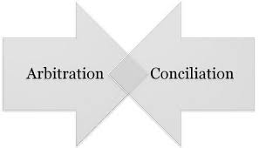
Conciliation & Arbitration Scheme
By
Ciaran Rohan
General Secretary

Slide 72
Conciliation &Arbitration Scheme
Governs the conduct of Industrial Relations in the Civil Service
Comprised General Council and Departmental Council
Staff Panel comprised of staff side unions.
Four unions on the staff side (2 general and 2 departmental)
AHCPS, FORSA, Prison Officers Association (POA) and Veterinary Officers Association (VOA)
Covers all grades below Assistant Secretary level
PO can only partake on issues relevant to their own grade.

Slide 73
Conciliation &Arbitration Scheme
Staff Panel elect Chair, Vice Chair and Secretary at AGM
Staff Panel meet 2nd Wednesday each month.
Claims for lodging at General Council are agreed at Staff Panel meeting
While a claim may be lodged by a particular union, once agreed at staff panel they become a staff panel claim at General Council
Subjects for discussion include Recruitment, Pay, allowances, T&S, attendance, promotion, discipline, superannuation, leave, blended working
General Council meet last Wednesday of each month.

Slide 74
Conciliation &Arbitration Scheme
Claim lodged by staff side responded within 2 meetings by official side.
Will draw up a report recording agreement or disagreement.
General Council may also establish sub committees to deal with issues.

Slide 75
Conciliation &Arbitration Scheme
Departmental Council:
Each Civil Service Department/Office has a Departmental Council
Comprised of Official side (Management) and staff side (Unions)
Chaired by Assistant Secretary or equivalent grade who acts independently.
Generally meets 4-6 times annually
Deals with issues exclusive to department.
Subjects for discussion include – departmental recruitment, promotion, grading, accommodation, blended working.

Slide 76
Conciliation &Arbitration Scheme
Lodge claims
Agreed/disagreed reports
Sub committees
Both General Council reports and departmental reports can be referred to third party (Arbitration)
Three elements
Facilitation (mediation) CS mediator Joe Mc Dermott
Arbitration (Loughlin Quinn Chair, Angela Kirk, David Denny)
Adjudication (Tom Clarke)

Slide 77
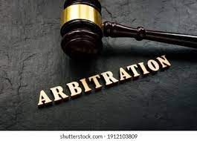
Conciliation &Arbitration Scheme
Facilitation may be used to aid the negotiation process. To try and bring both sides to an agreement.
Two forms of Arbitration
1) Arbitration Board appointed by Government
Consists of a chair
Member nominated by staff side
Member nominated by Government
2) Adjudication

Slide 78
Conciliation &Arbitration Scheme
For a claim to be eligible for arbitration it must
Be arbitrable
Discussed at General or departmental council
Been subject to an agreed report recording disagreement or
Been rejected by the minister.
Staff side make a statement of case and sent to secretary of the board. This is shared with the Official side.
Official side make a statement of case which is shared with the staff side.
Arbitration Board/Adjudicator also have statement of case in advance.

Slide 79
Issues for Arbitration
pay and allowances
overtime
total weekly hours of work
annual and sick leave
Subsistence, travelling, lodging, disturbance allowances and removal expenses
compensation for loss of earnings

Slide 80
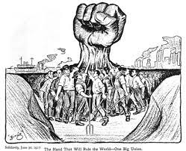
Industrial Action
“A union or staff association, recognised for the purposes of the Scheme, shall not threaten, sponsor, support or resort to strike, industrial action, or public agitation as a means of furthering claims which are appropriate to be dealt with through the Scheme where provisions of the Scheme have not been exhausted.”

Slide 81
State Bodies – Workplace Relations Commission (WRC)
IR Forum –Similar to Departmental Council
Issues not resolved referred to third party i.e. WRC
First stage conciliation conference – Facilitated by an Industrial Relations Officer (IRO) of WRC
Usually management and staff side start off in different rooms
Come together and thrash out differences in front of IRO
Generally break into separate rooms and IRO moves between rooms
Aim is to resolve issues or narrow down issues for referral to Labour Court

Slide 82
Labour Court
Formal Body. 3 Persons. Chair, Employers rep (IBEC) and Union rep (ICTU). All full time and appointed by Government. 4 Divisions in Court
Both sides submit their case a week in advance and swap with each other at the start of hearing.
Case is read into the record and then both sides are questioned by court.
Court issues a written recommendation within a few weeks.

Slide 83
Conflict in the Workplace - Personal
Conflict between Management and staff – dealt with through IR forums
Conflict between individuals
Grievance Procedure
Dignity at Work Policy

Slide 84
Grievance
Grievance Procedure – Covered by Circular 11/2001
Deals with complaints not appropriate to C&A scheme
Seeks to deal in a fair, prompt and impartial manner, complaints of individual staff.
Complaints by officers about acts or omissions of management
2 Stages.

Slide 85
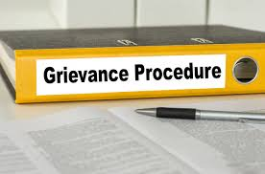
Grievance
Stage 1 – 4 parts
Complainant and officer. Whose act or omission is complained of shall discuss the matter with a view to resolve it informally
If not possible to resolve, complainant outlines complaint in writing to the officer concerned, with a copy to the officers superior, indicating they are invoking the grievance procedure and the corrective action sought. Officer complained against shall reply within 2 weeks.

Slide 86
Grievance
If complainant not satisfied with response may refer the matter to Personnel. Within 2 weeks Personnel arrange meeting between 2 parties. Complainant can be accompanied by union rep.
If not possible to resolve matter by agreement, Personnel shall make a decision on the complaint and convey the decision, plus the reason to the parties in Writing.

Slide 87
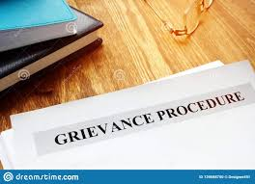
Grievance
Stage 2
Complainant who is dissatisfied with decision may make a written request to Personnel that the dispute be referred to Mediation Officer. Complaint will be dealt with on the following basis
Complaints concerning the following shall not be referred to the Mediation Officer
Disciplinary action taken under the disciplinary code
Selection for promotion
Selection for assignment to a post carrying an allowance/post abroad/higher scales under restructuring agreement
Exclusion from competitions or from consideration for promotion on health/Sick leave

Slide 88
Grievance
Mediation officer shall investigate the matter and mediate between the parties with a view to resolve issue.
Where not possible mediator will make a recommendation

